Slide 1
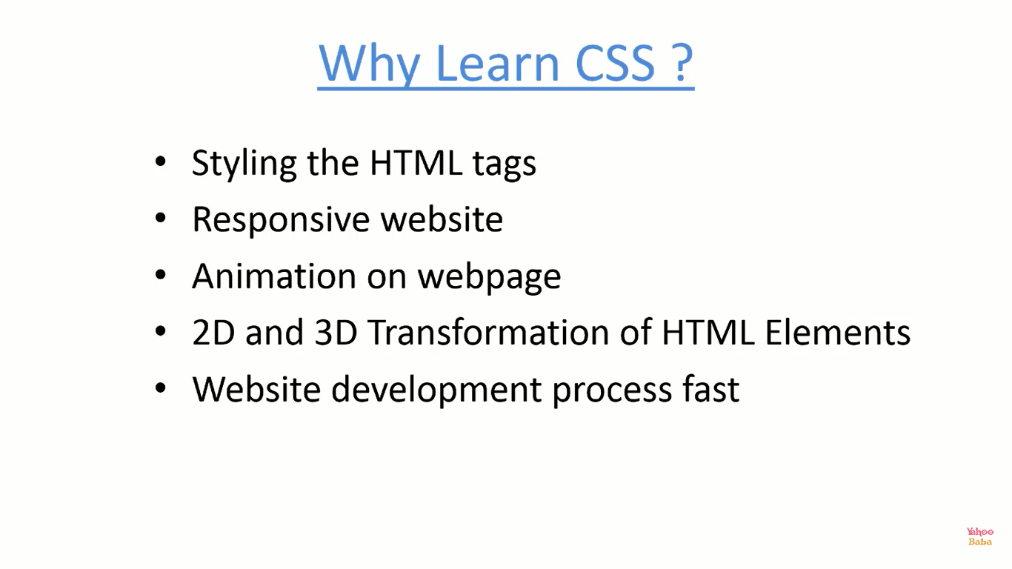

Slide 2
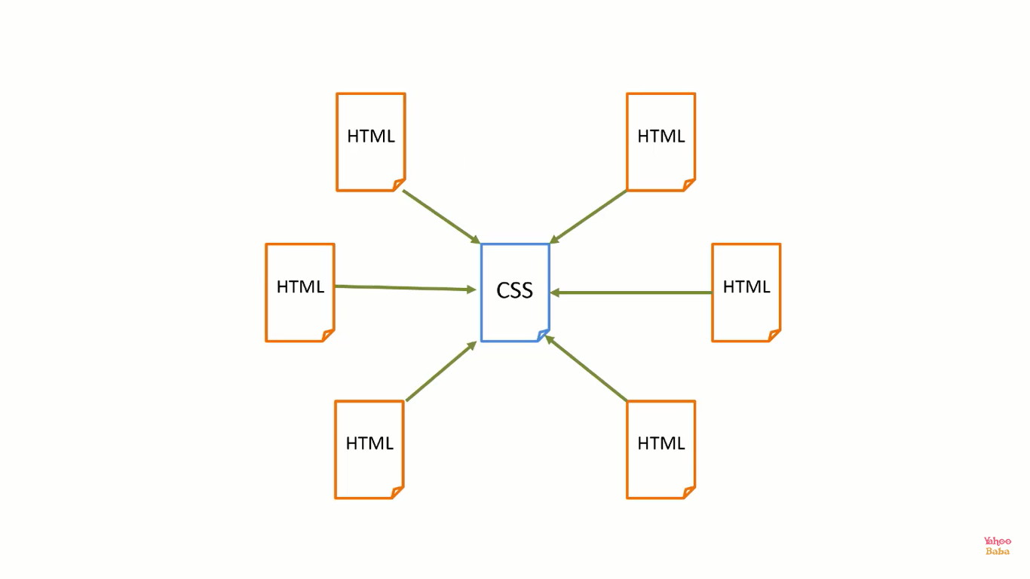

Slide 3
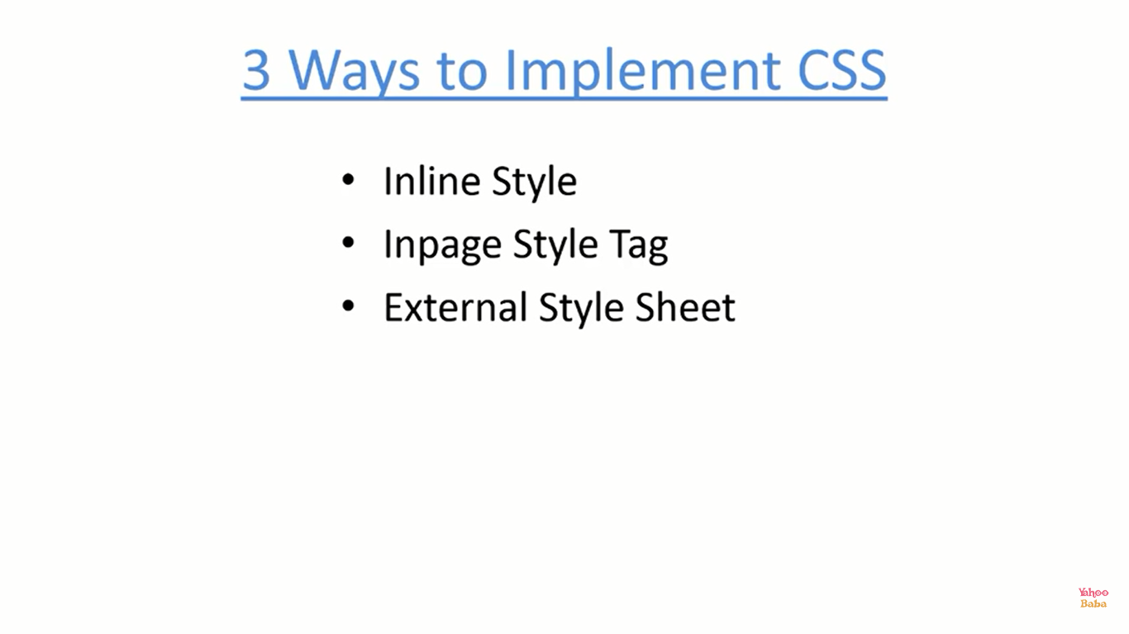

Slide 4
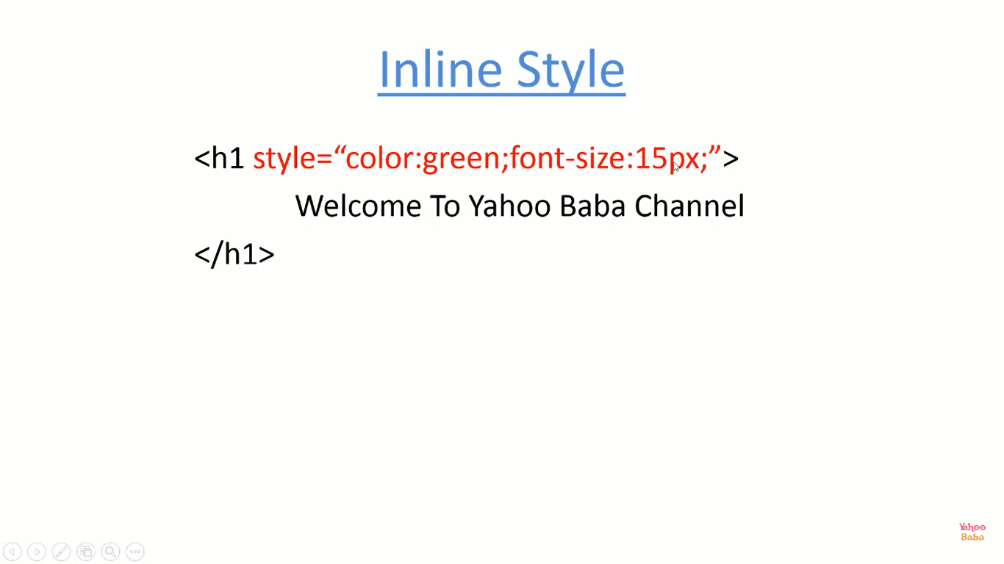

Slide 5
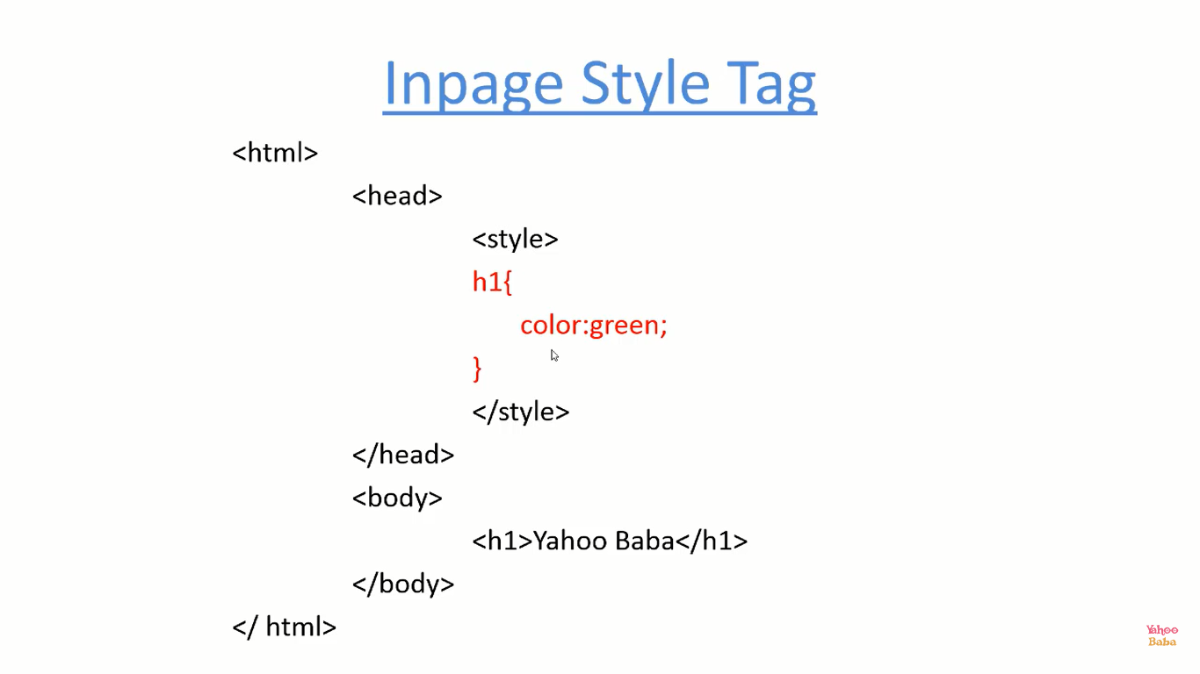

Slide 6
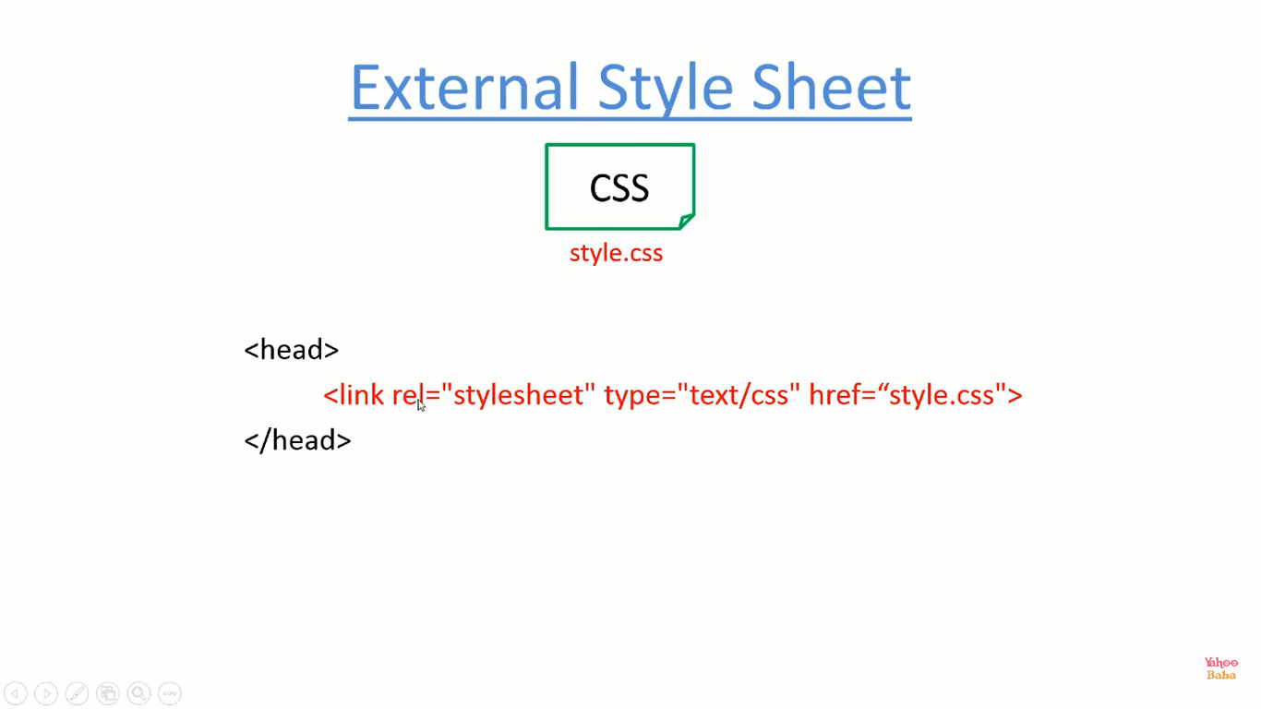

Slide 7
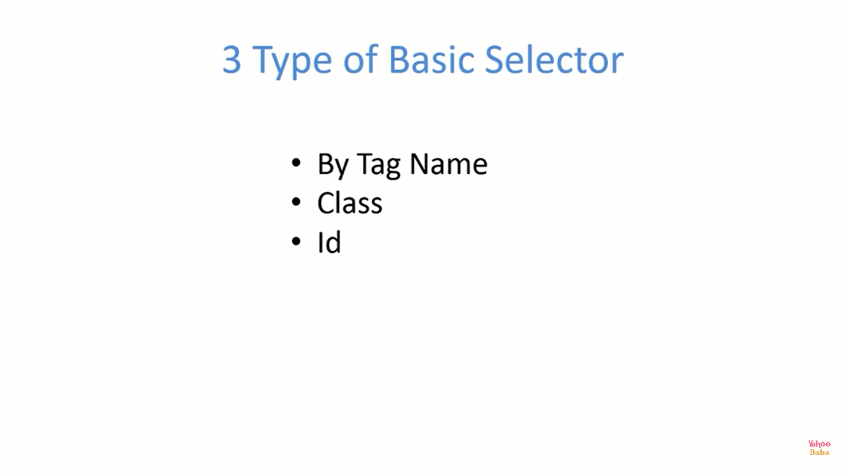

Slide 8
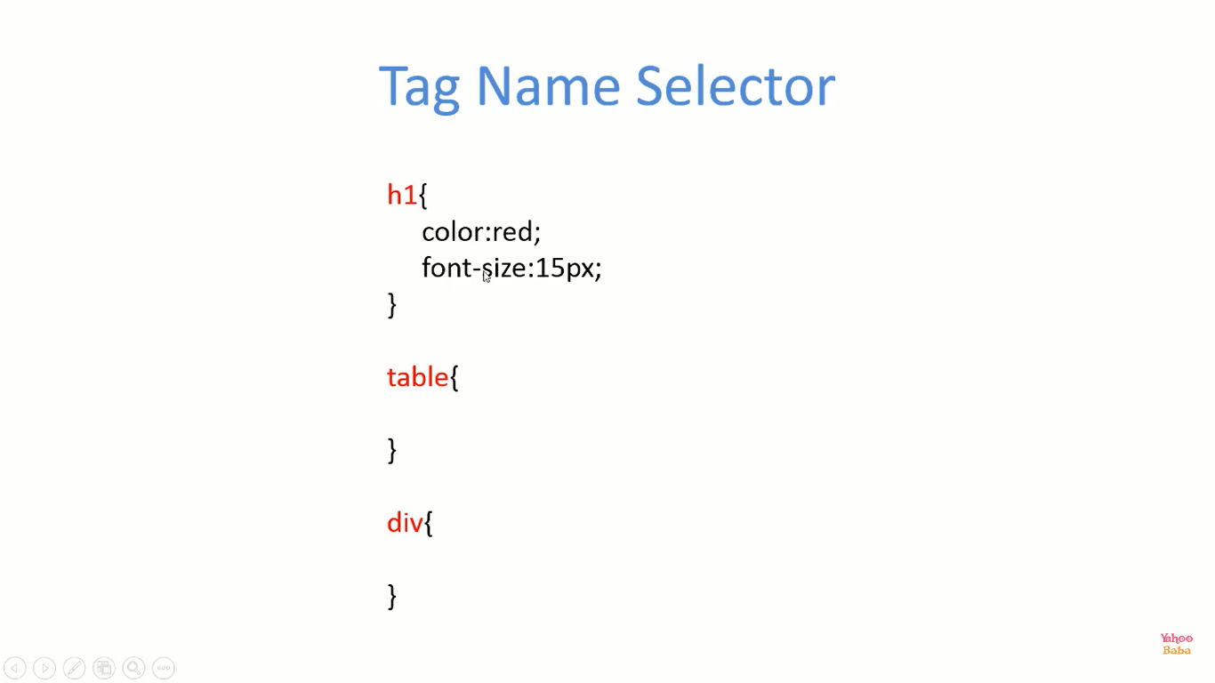

Slide 9
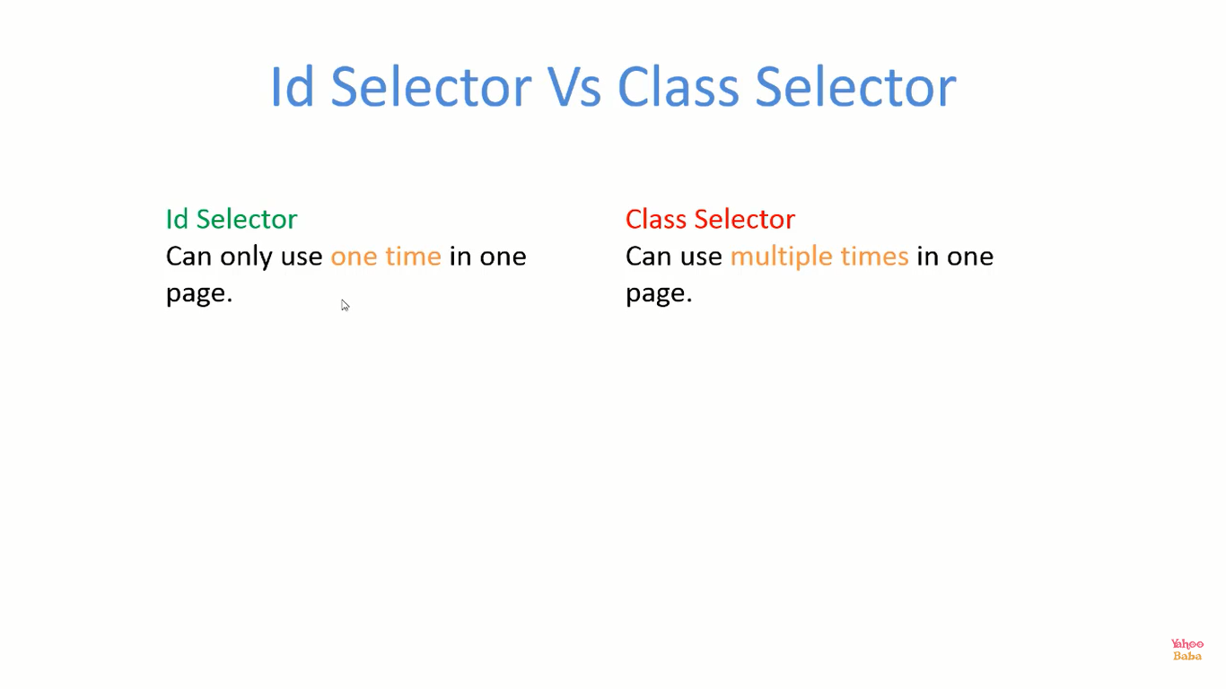

Slide 10
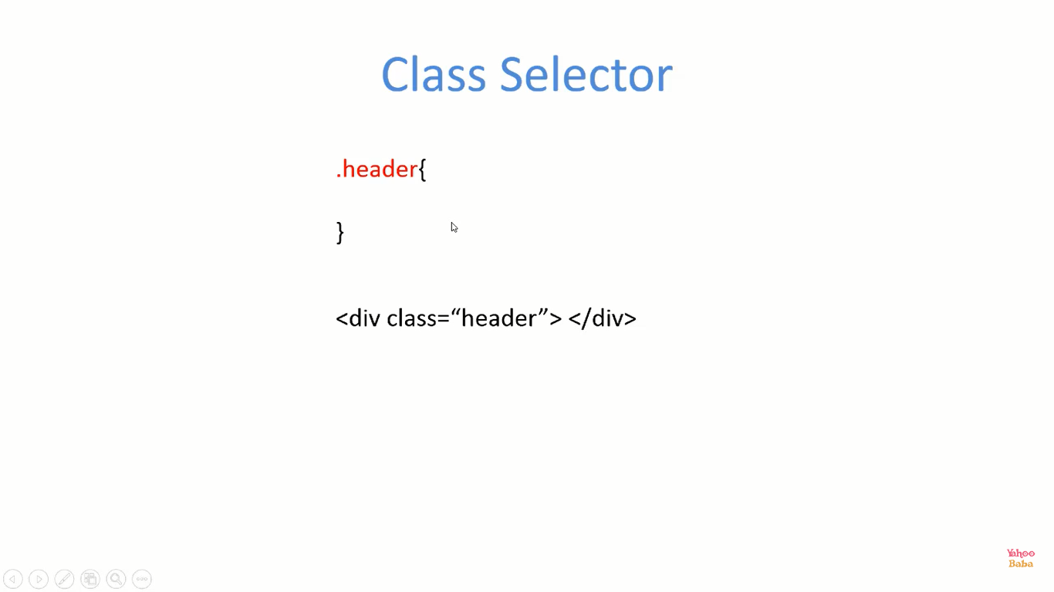

Slide 11
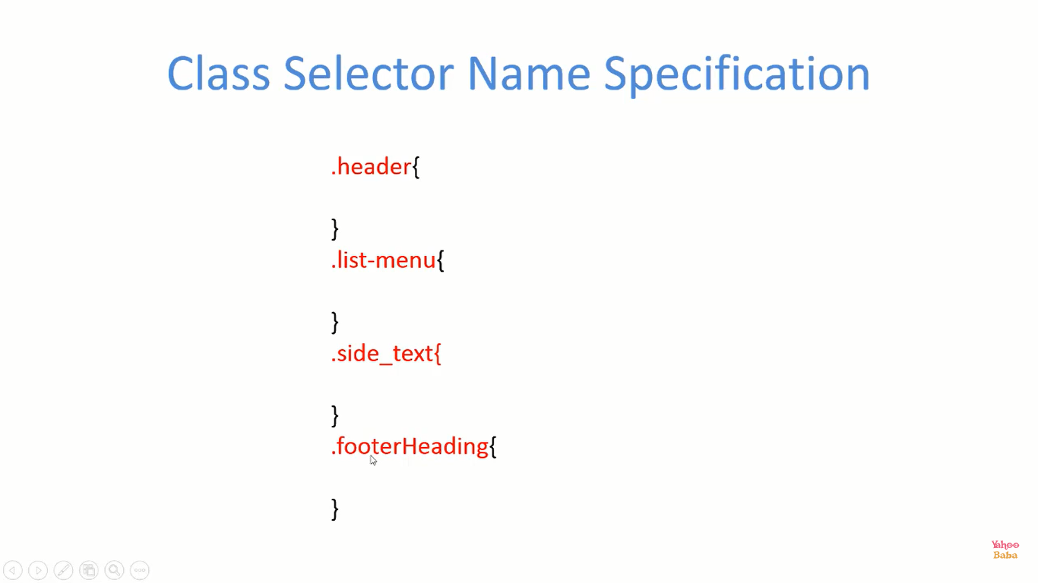

Slide 12
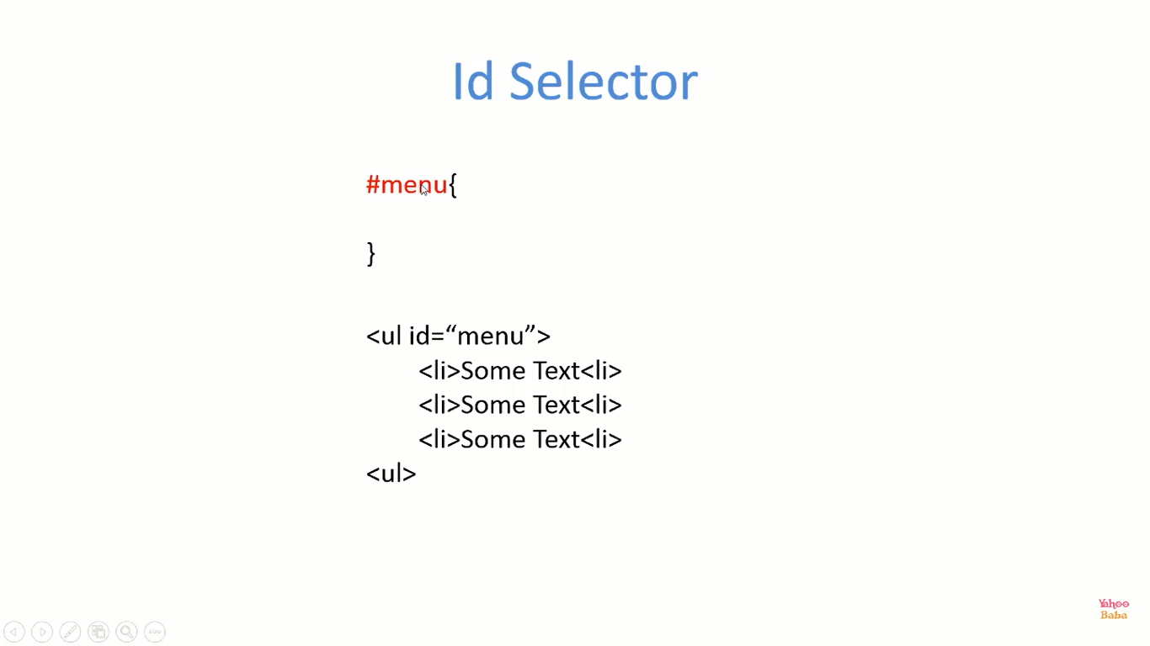

Slide 13
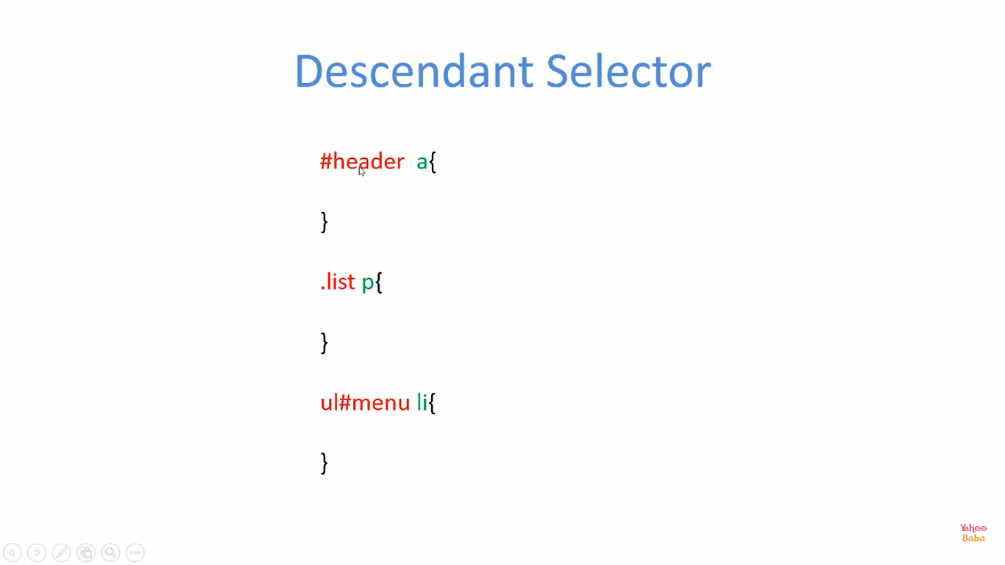

Slide 14
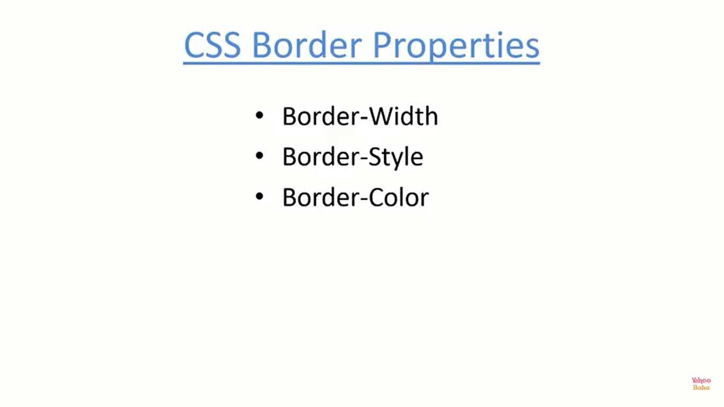

Slide 15
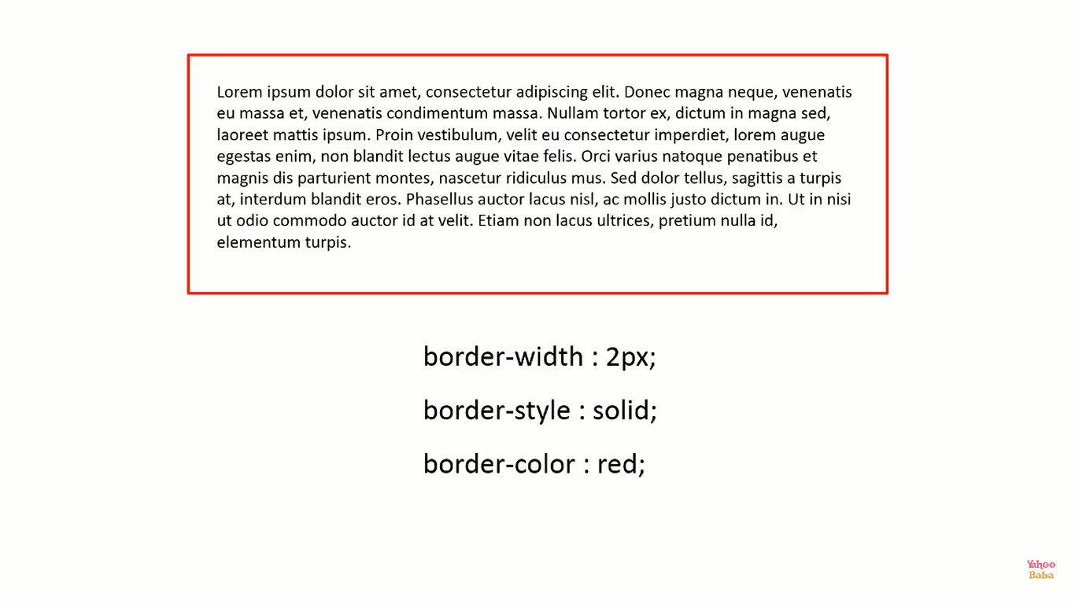

Slide 16
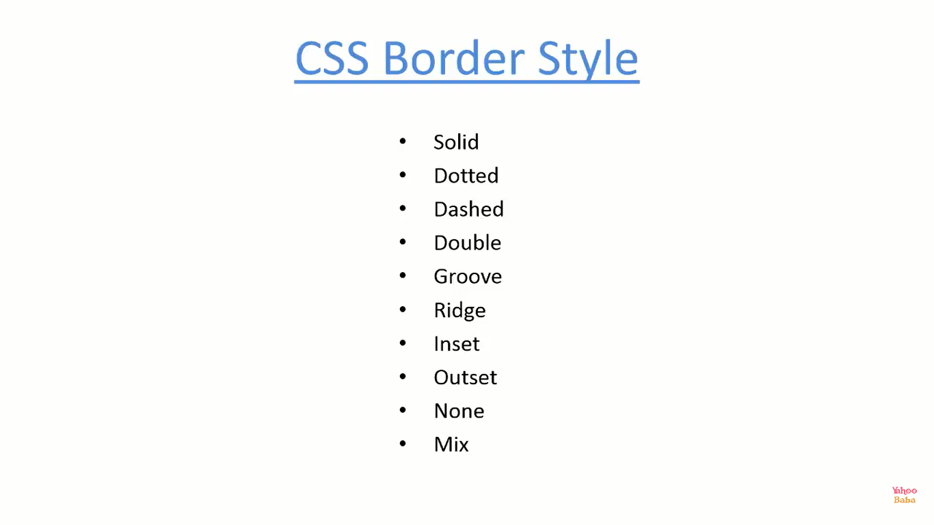

Slide 17
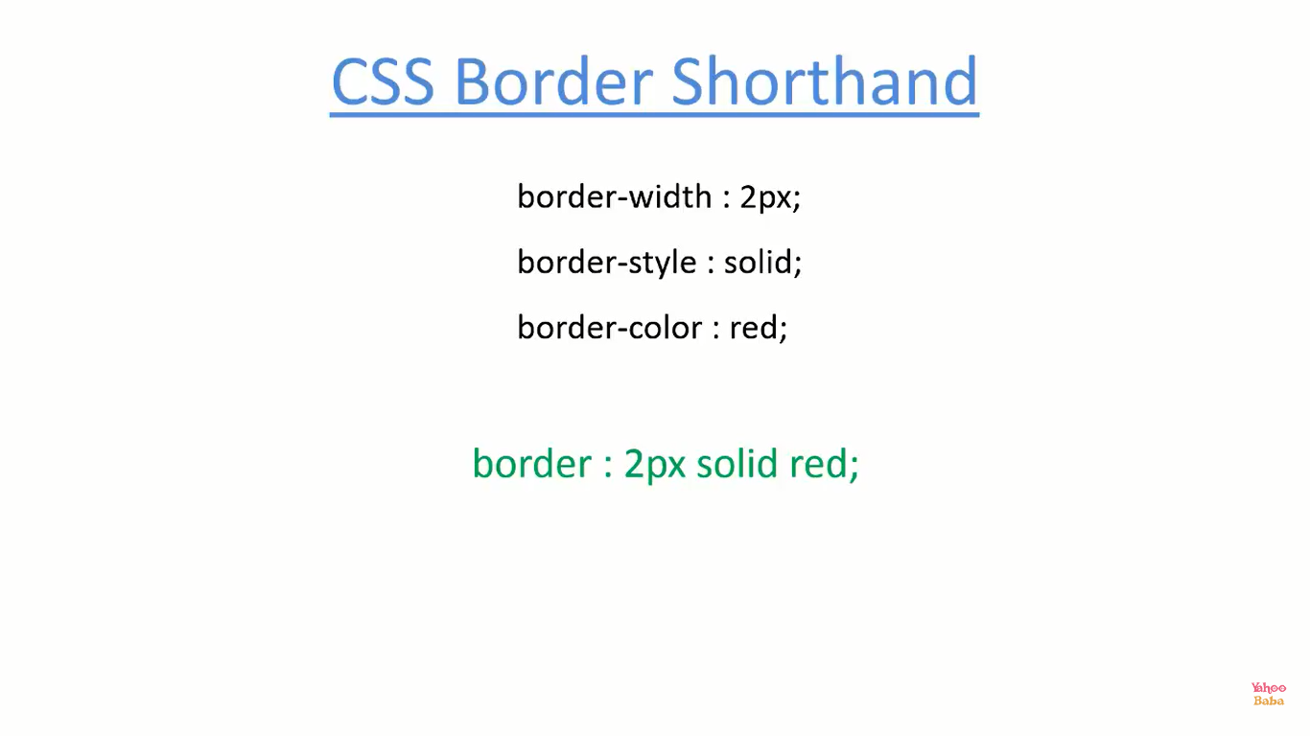

Slide 18
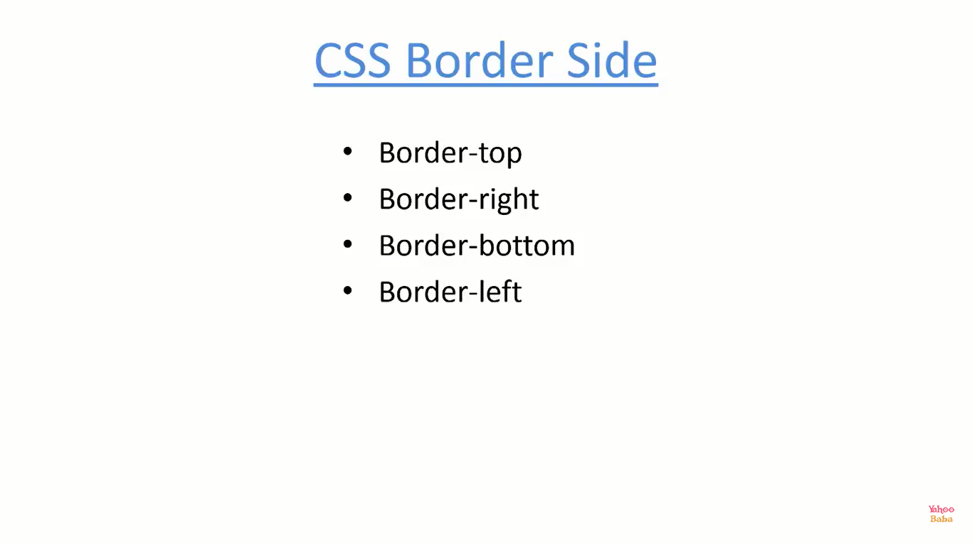

Slide 19
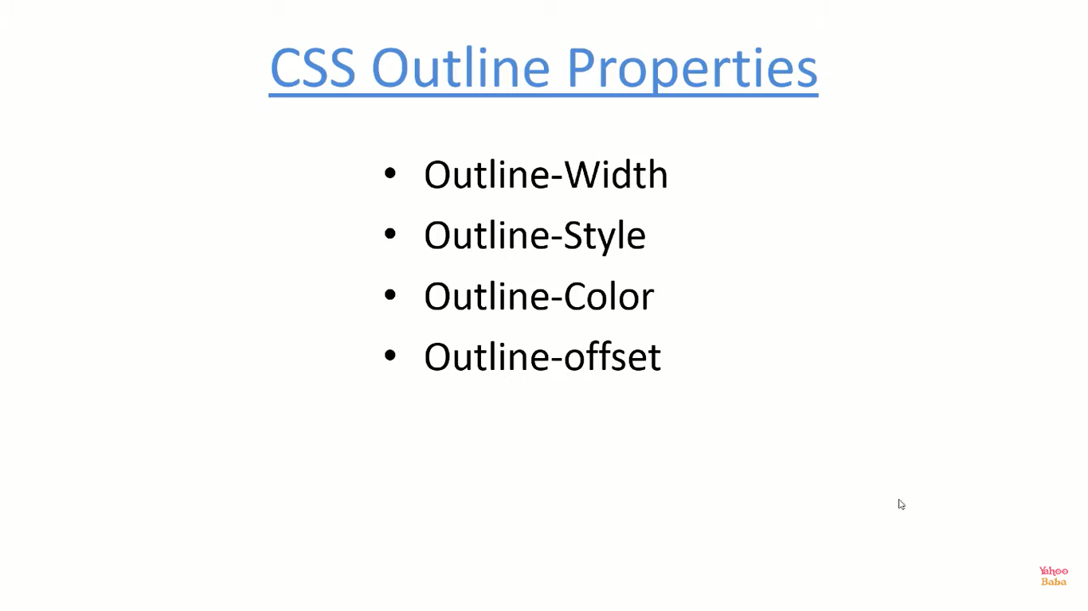

Slide 20
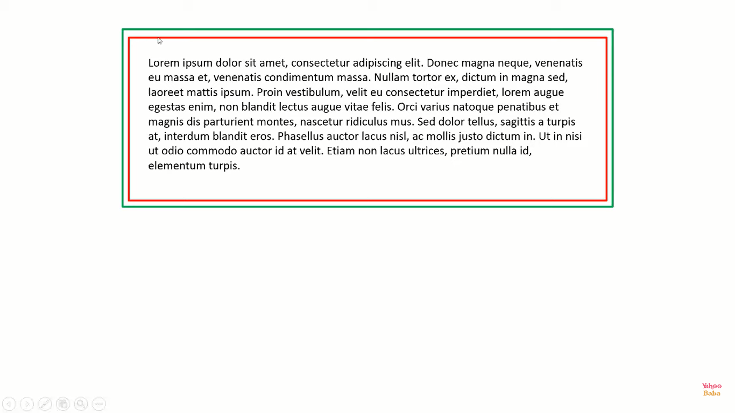
Border
Outline
Outline-Offset :- Distance/Gap between Border & Outline.

Slide 21
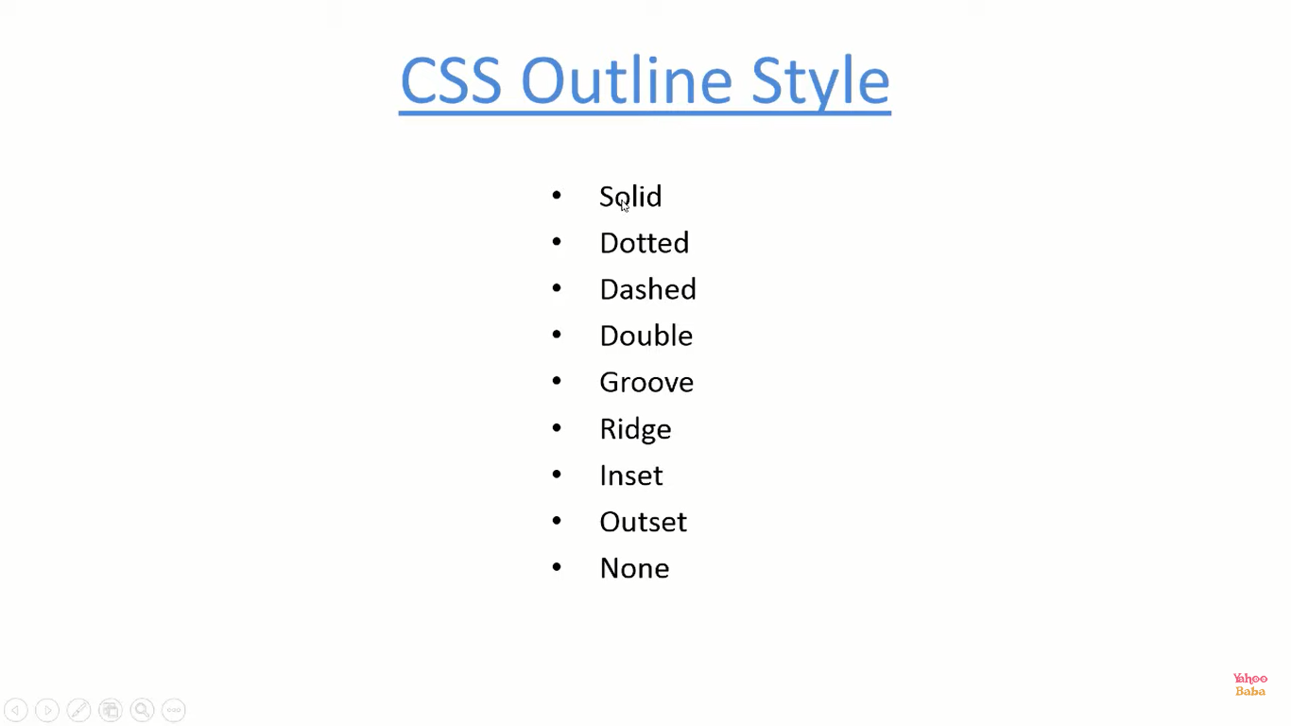

Slide 22
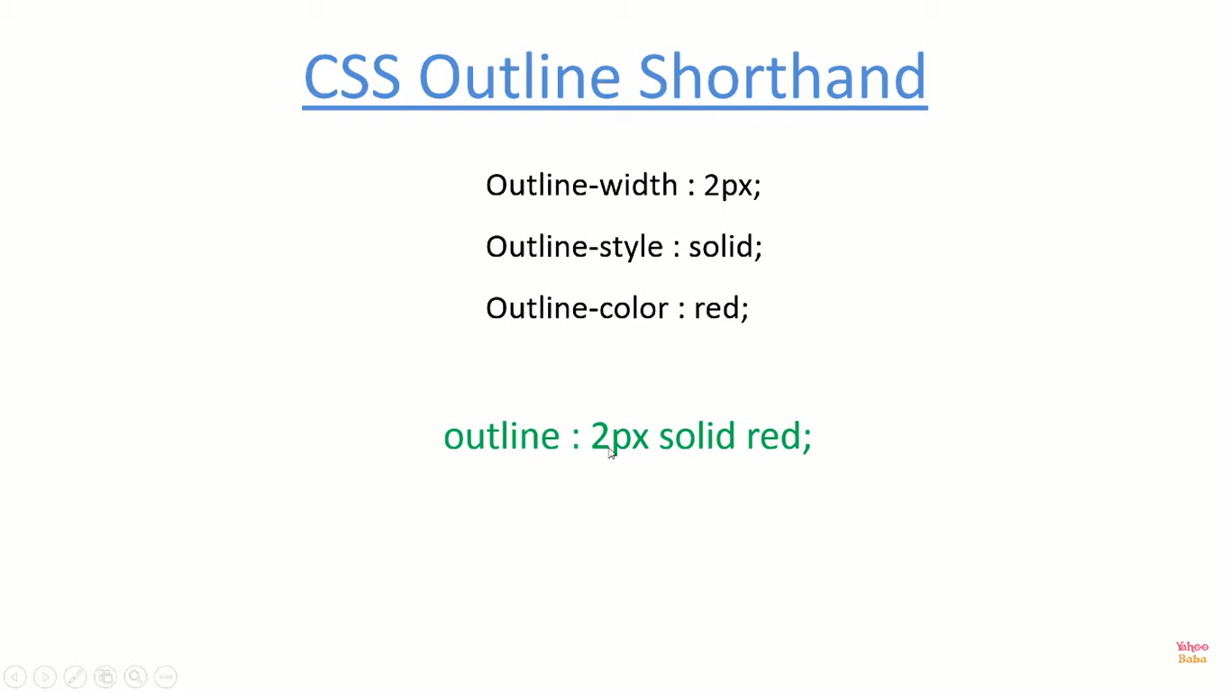

Slide 23
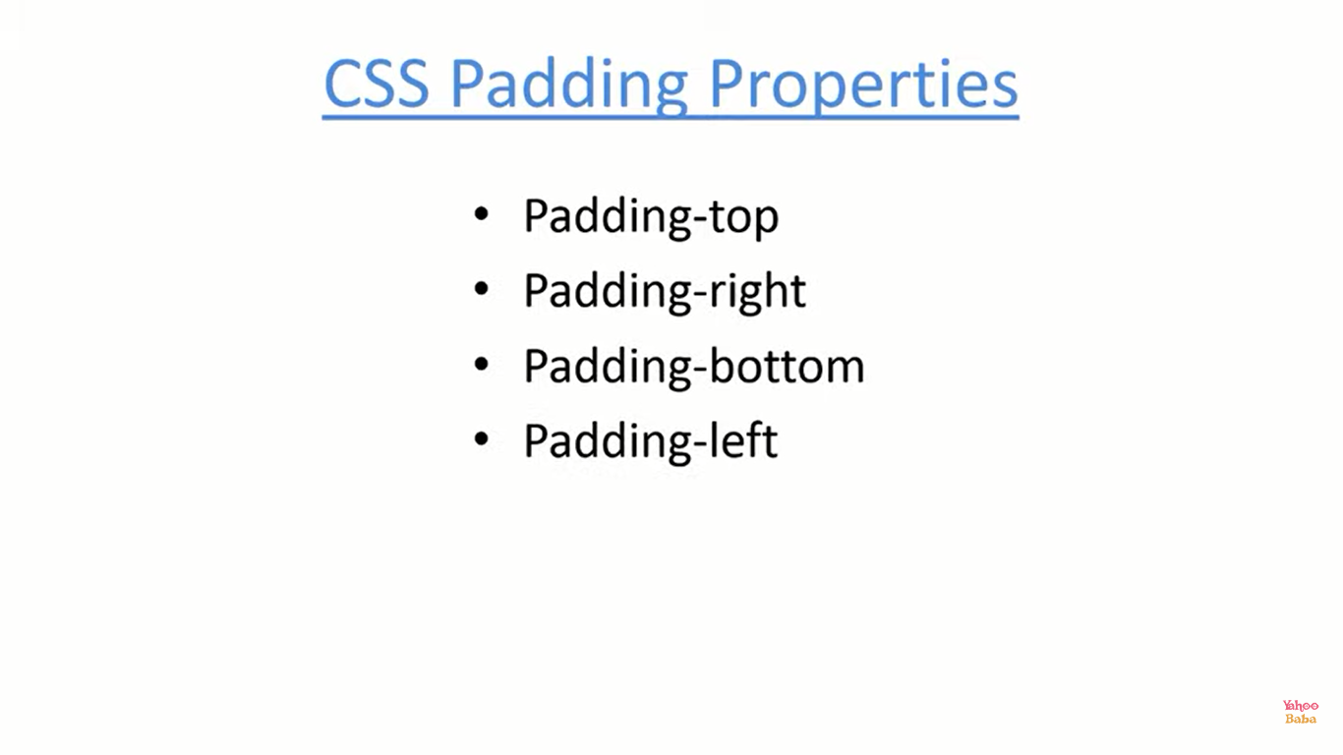

Slide 24
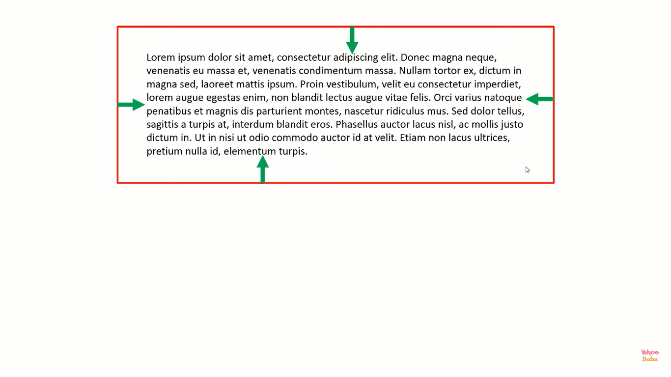

Slide 25
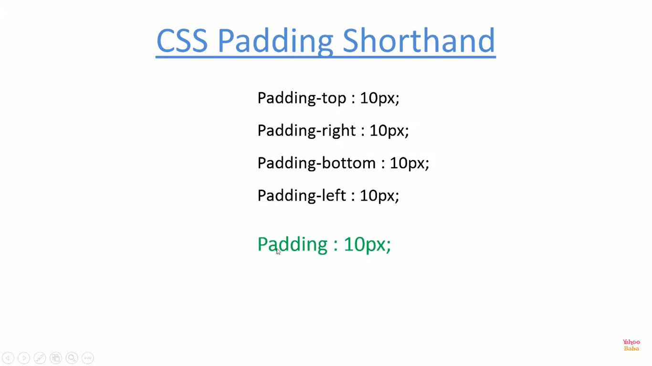

Slide 26
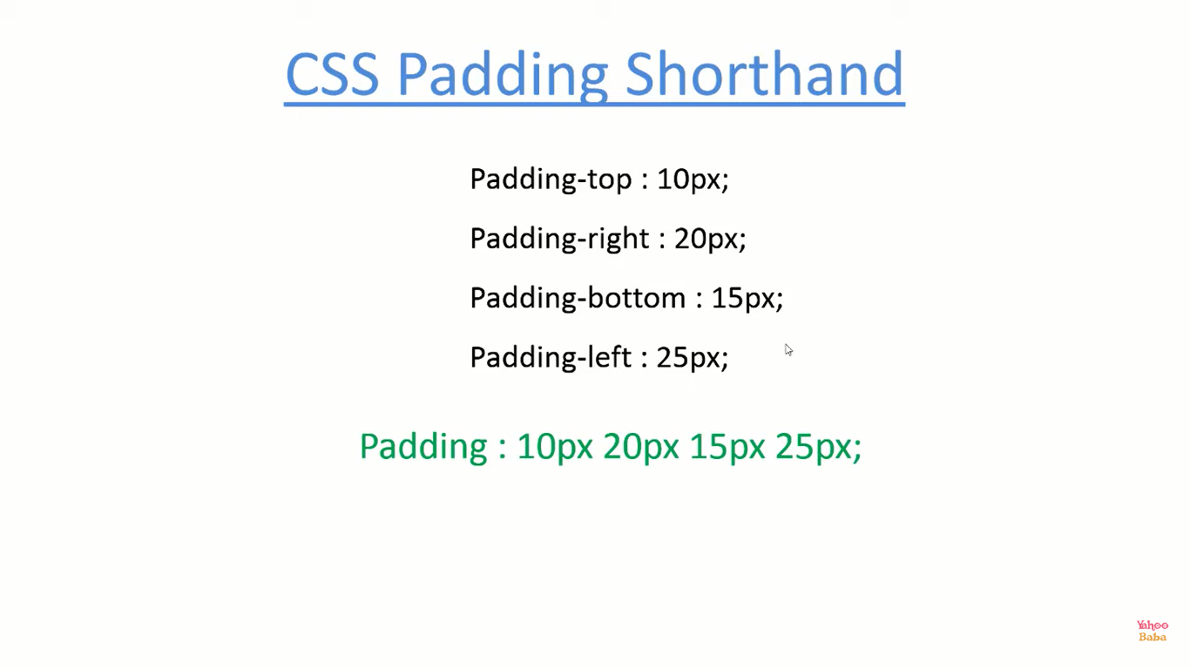

Slide 27
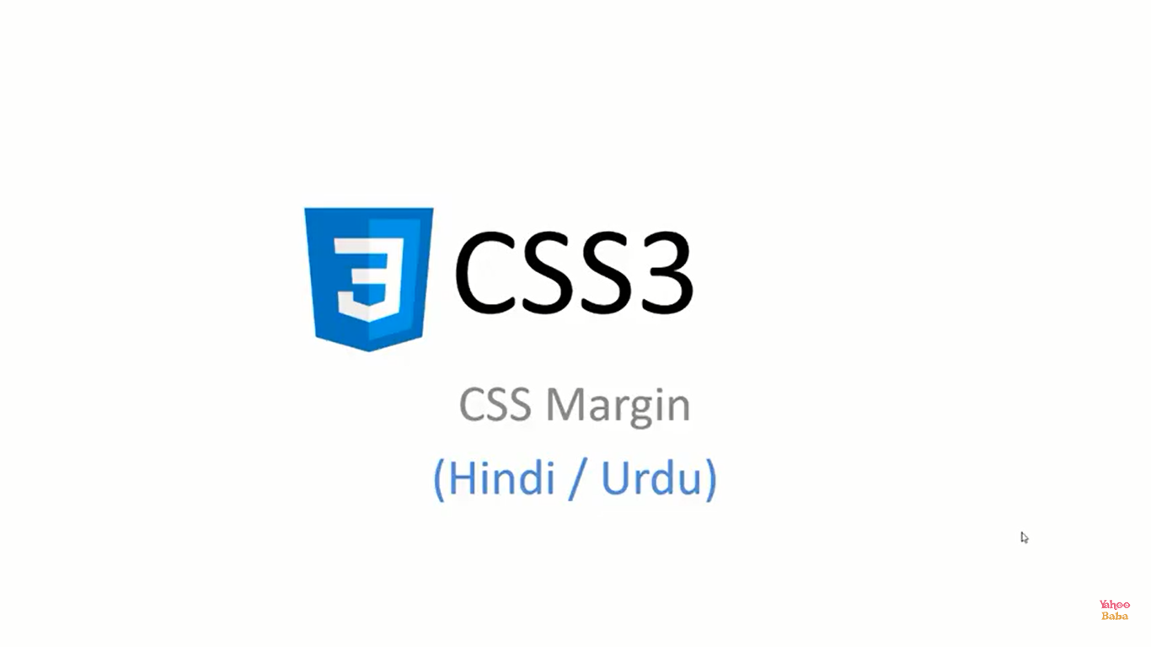

Slide 28
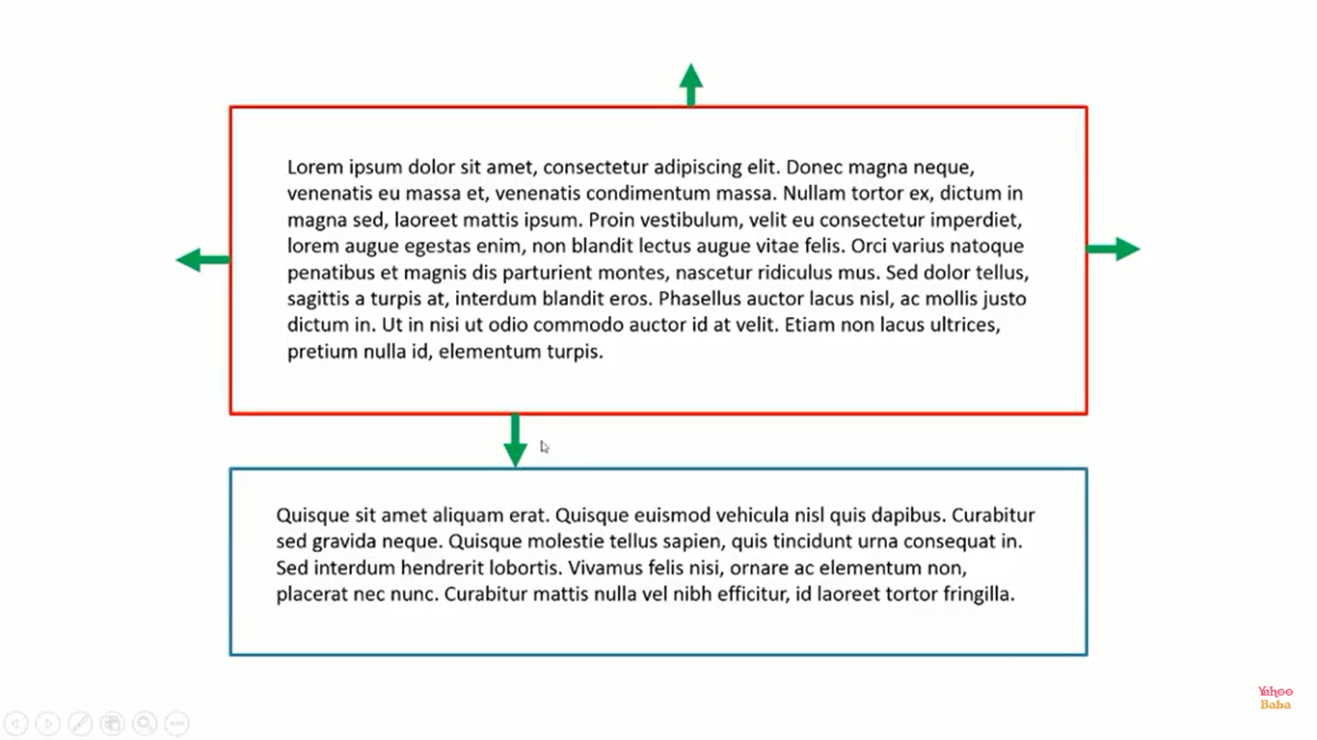

Slide 29
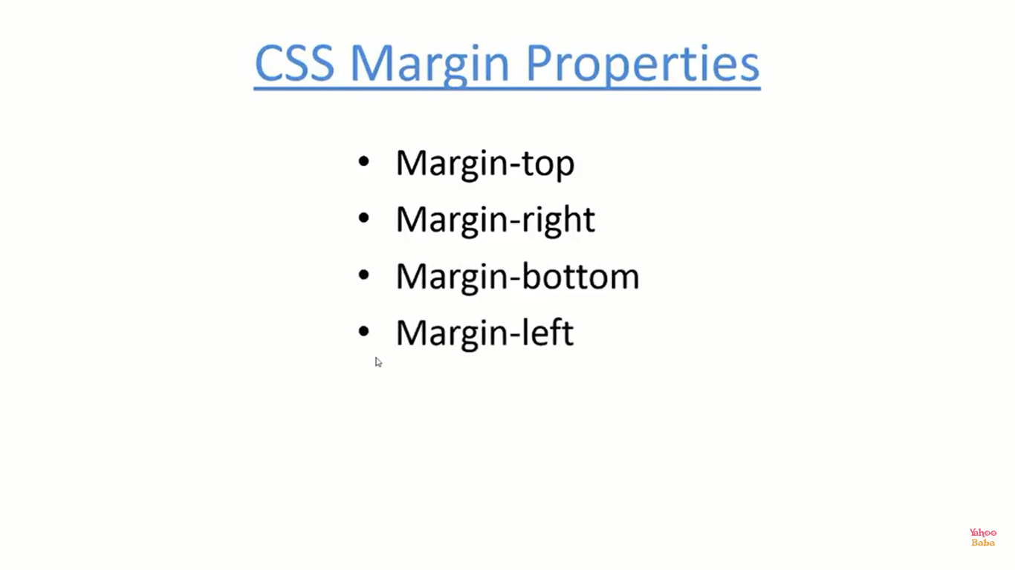

Slide 30
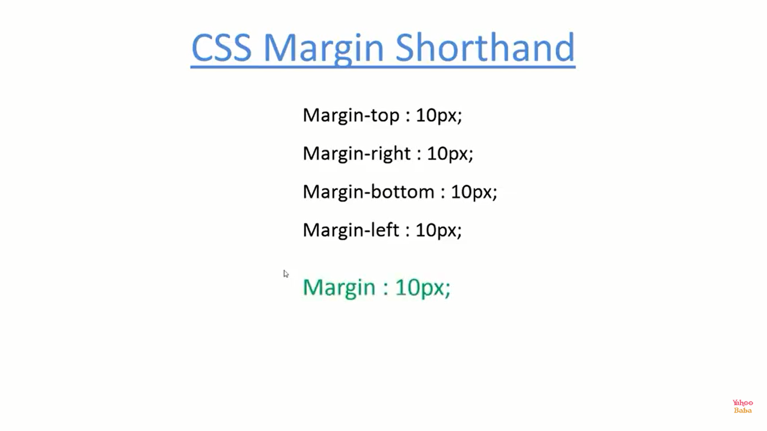

Slide 31
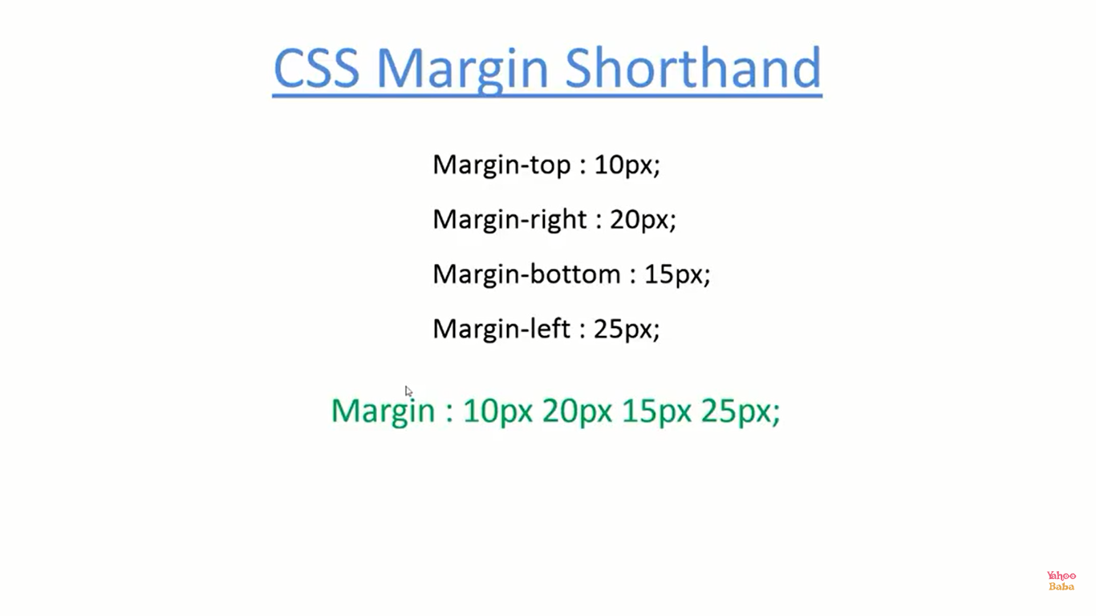

Slide 32
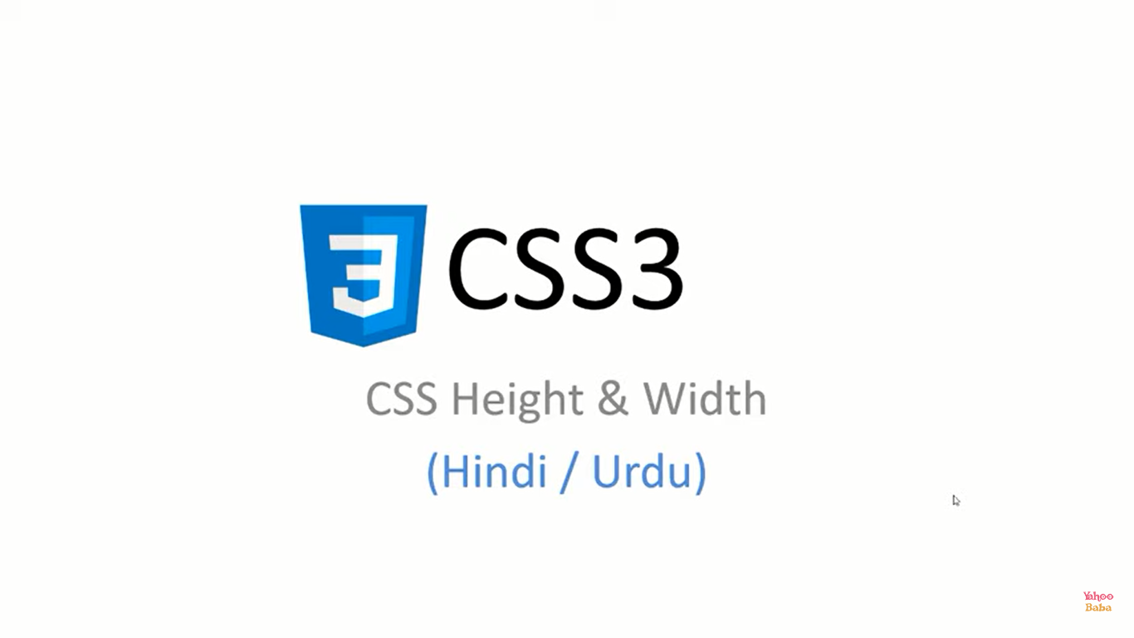

Slide 33
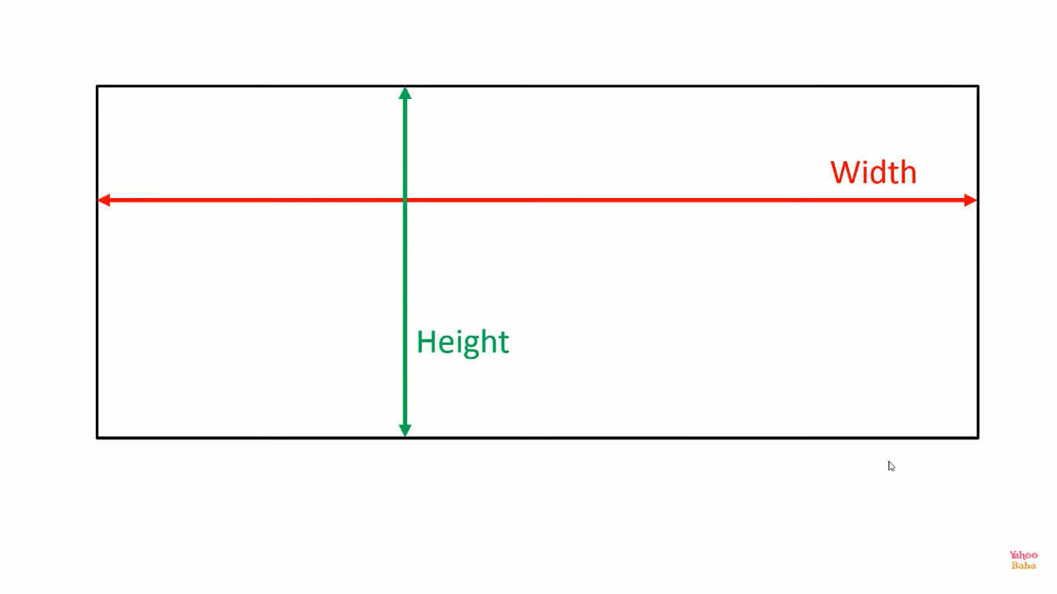

Slide 34
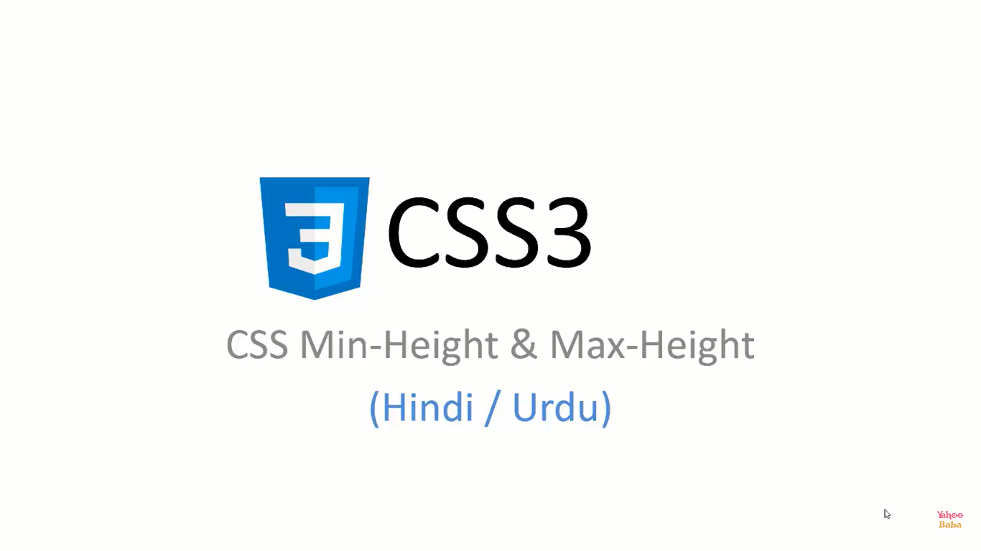

Slide 35


Slide 36
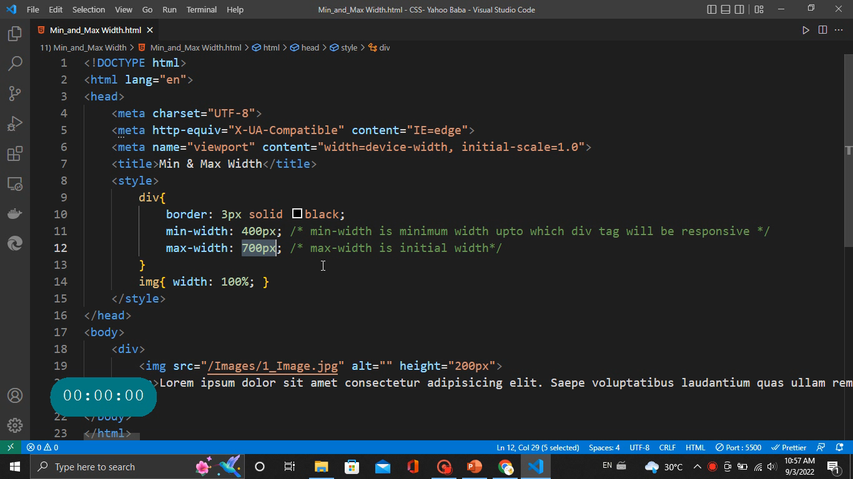

Slide 37

Total Width = Content Width + Padding + Border Width

Slide 38
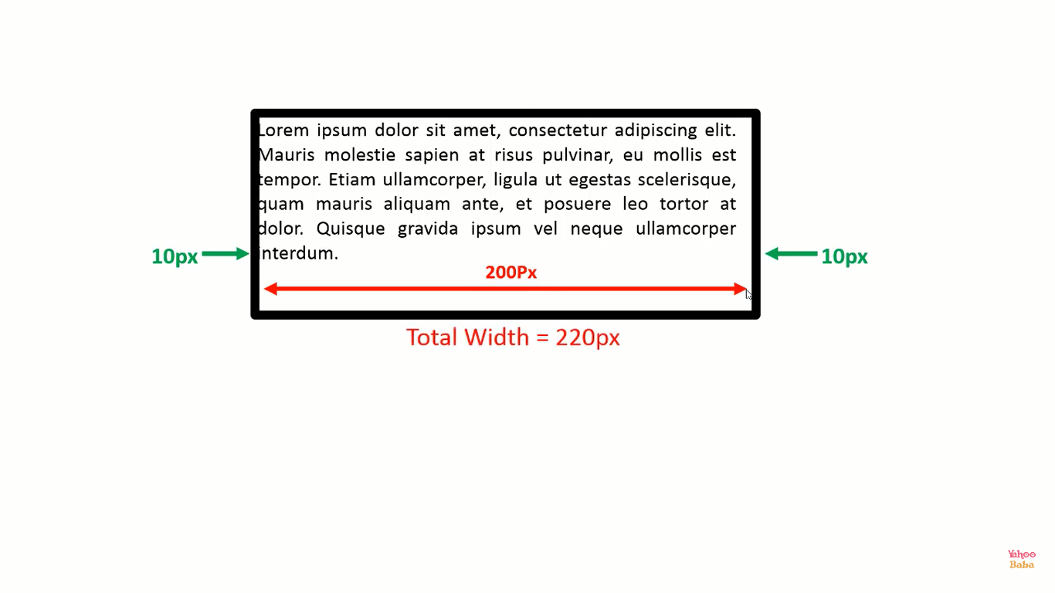
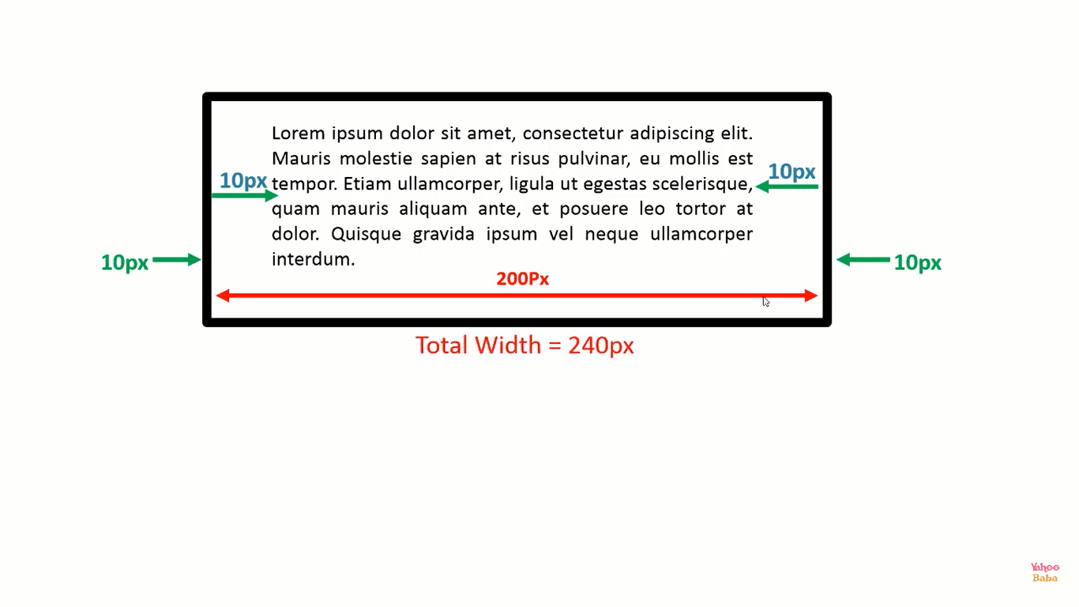

Slide 39
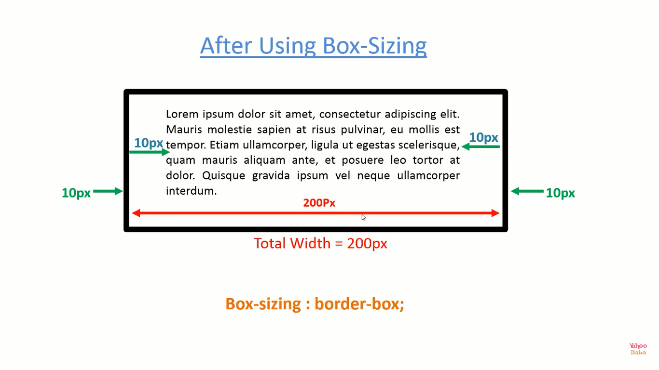

Slide 40


Slide 41
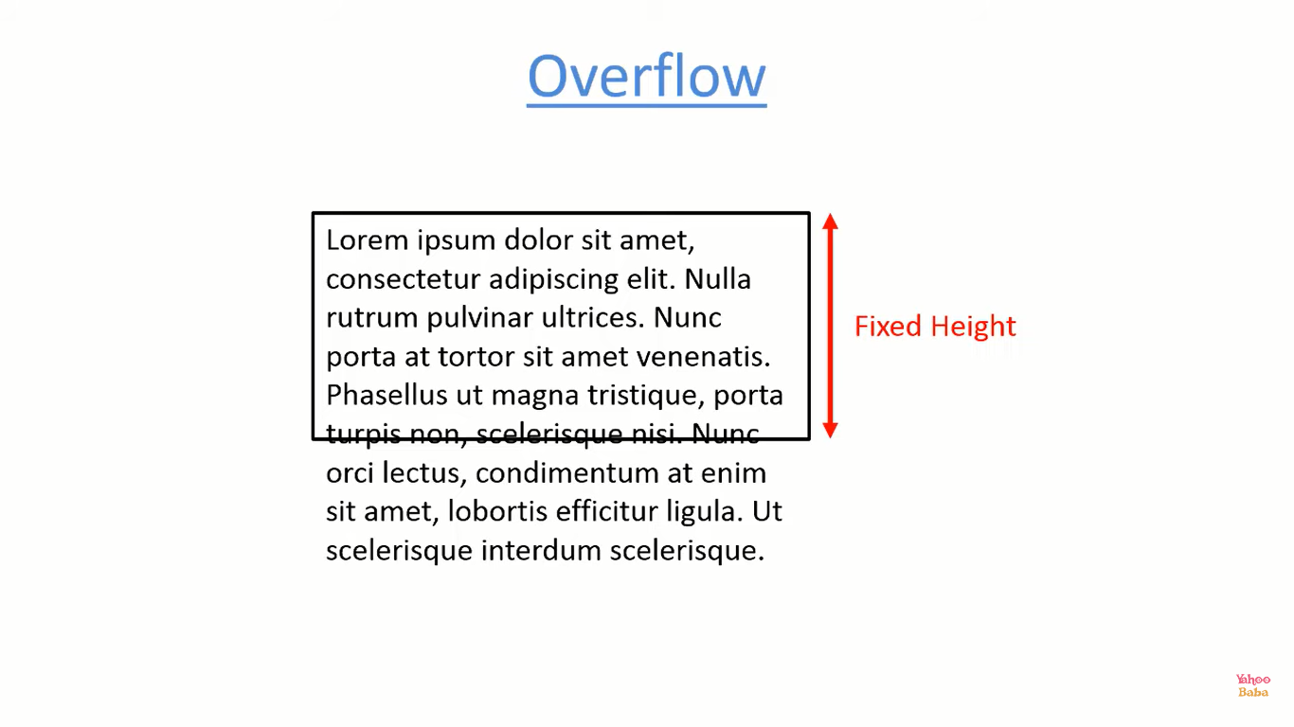

Slide 42
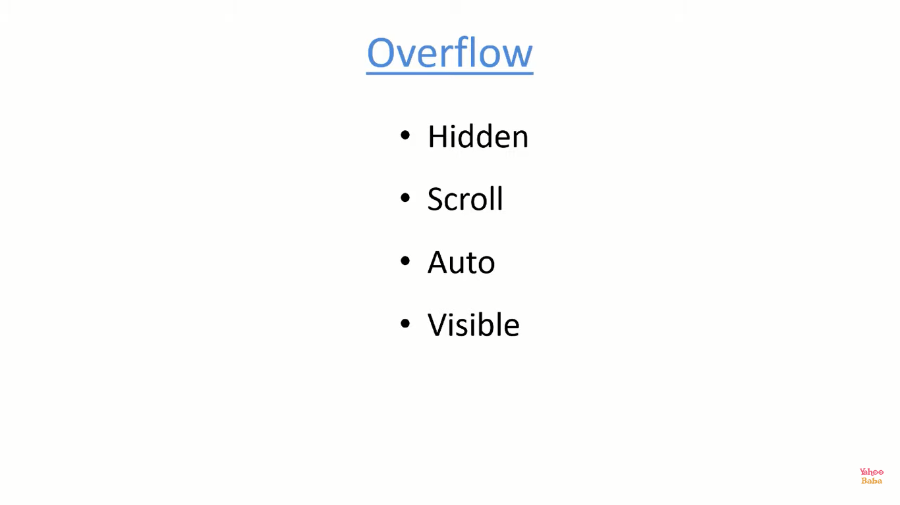
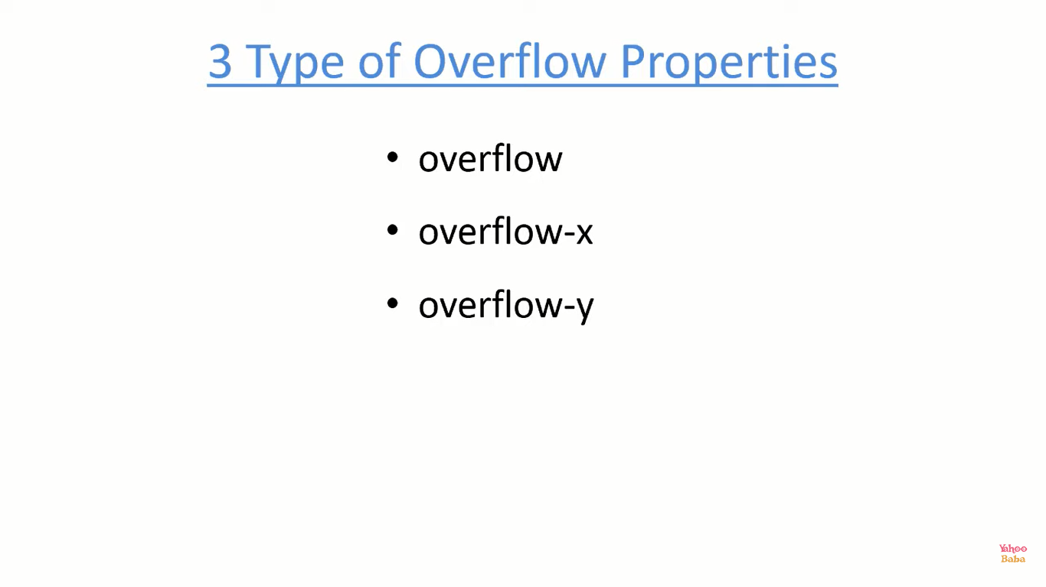

Applicable for both horizontal & vertical
Applicable for horizontal only
Applicable for vertical only
By Default

Slide 43


Slide 44
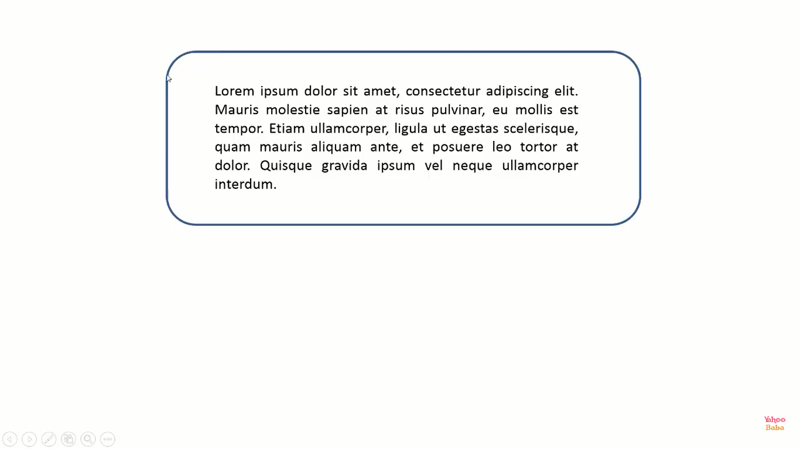

Slide 45
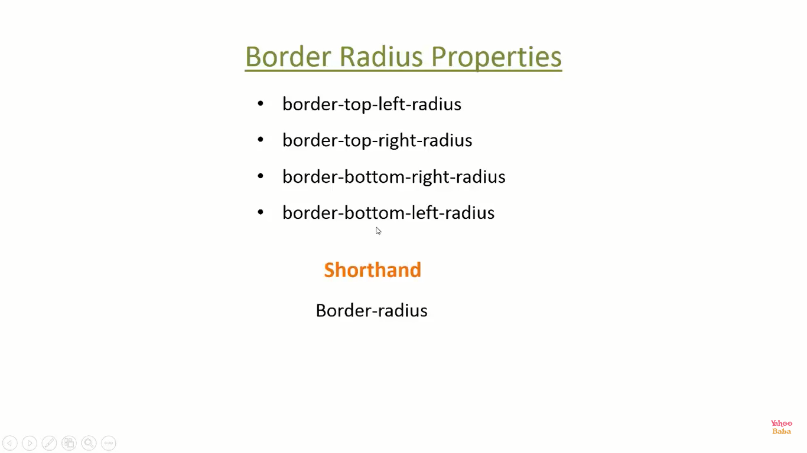

Slide 46
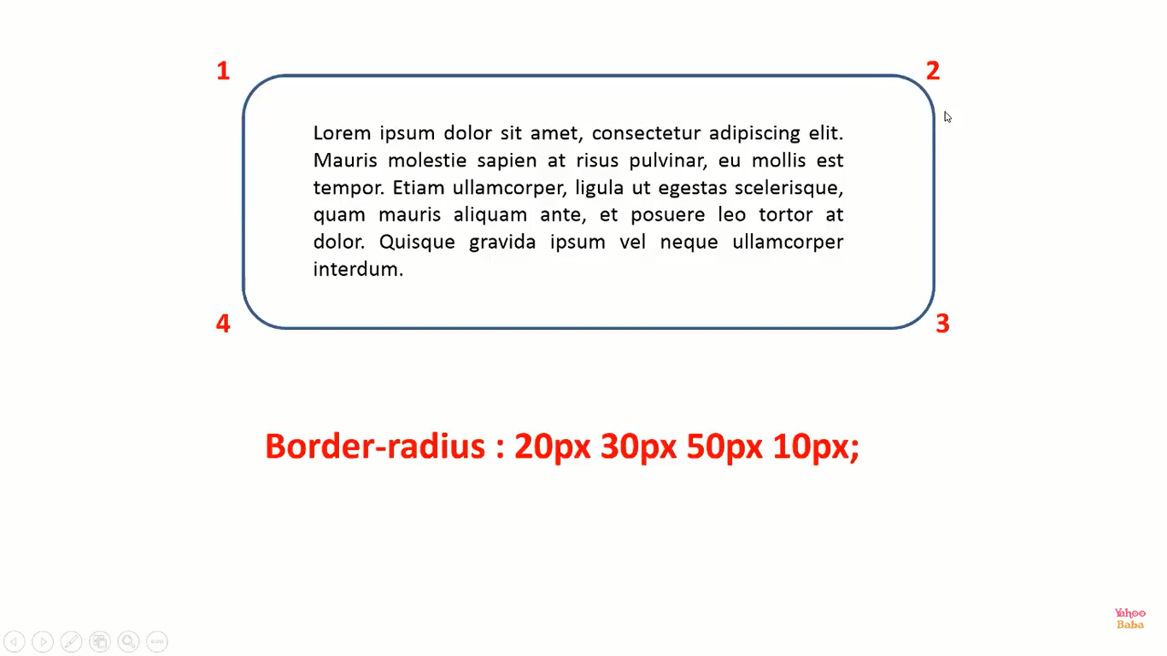

Slide 47


Slide 48
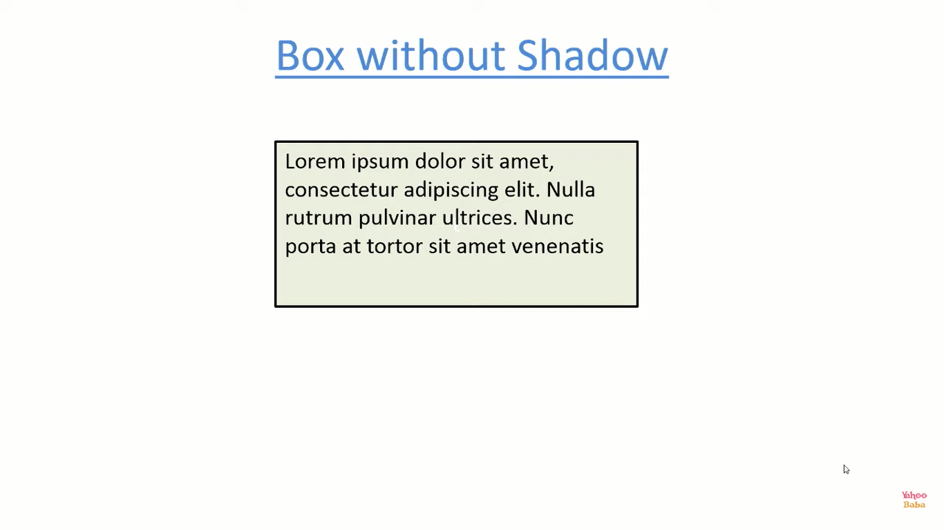
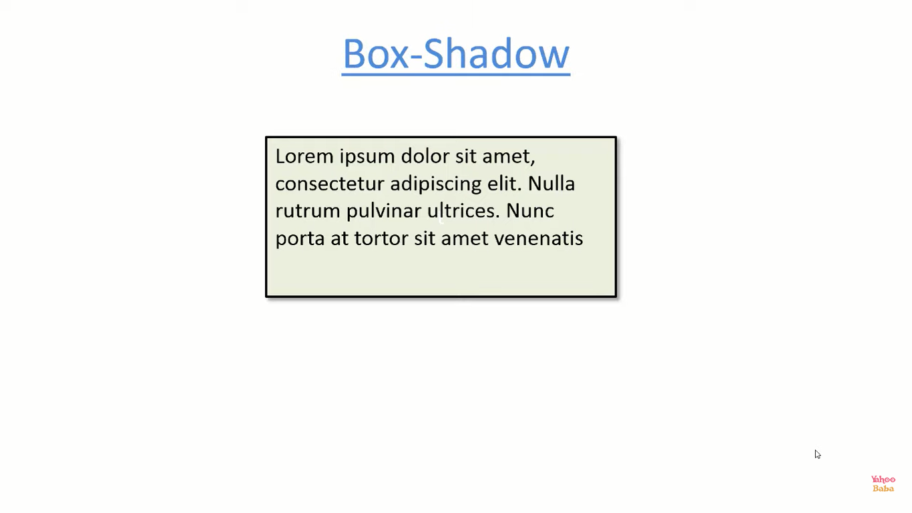

Slide 49
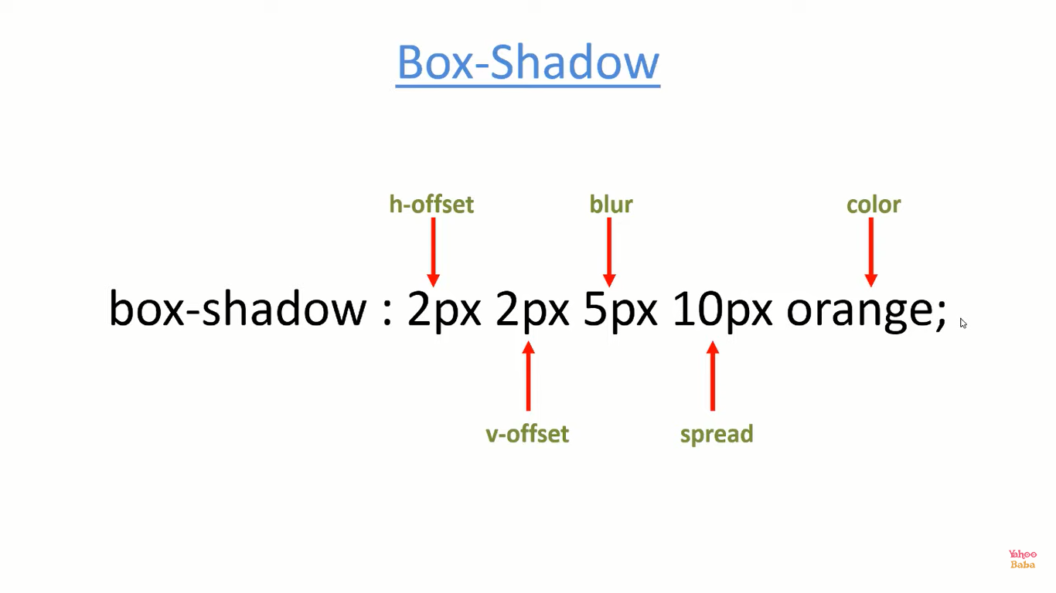
Outside the Box
Value of h-offset & v-offset can be in –ve also

Slide 50
Inside the Box
inset ;
Value of h-offset & v-offset can be in – also

Slide 51


Slide 52
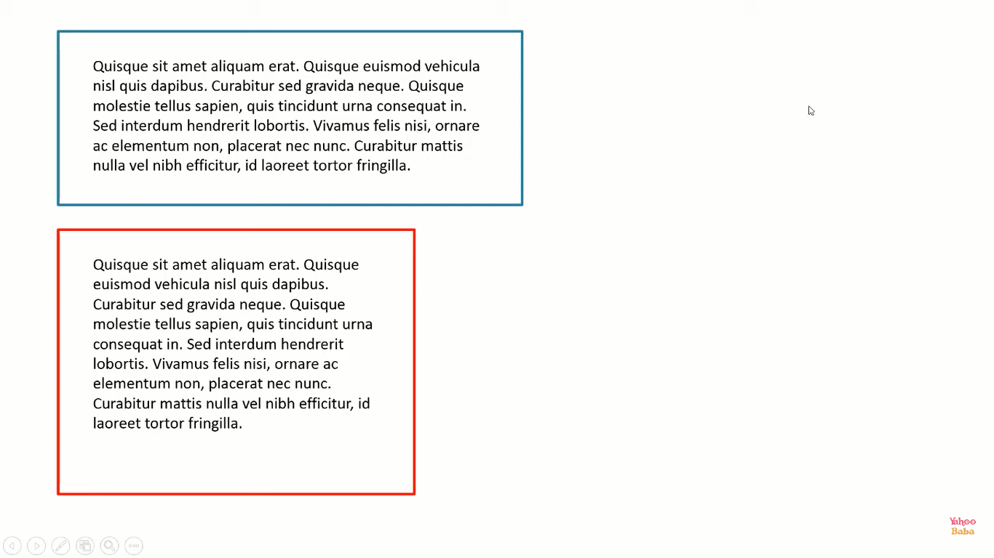

Slide 53
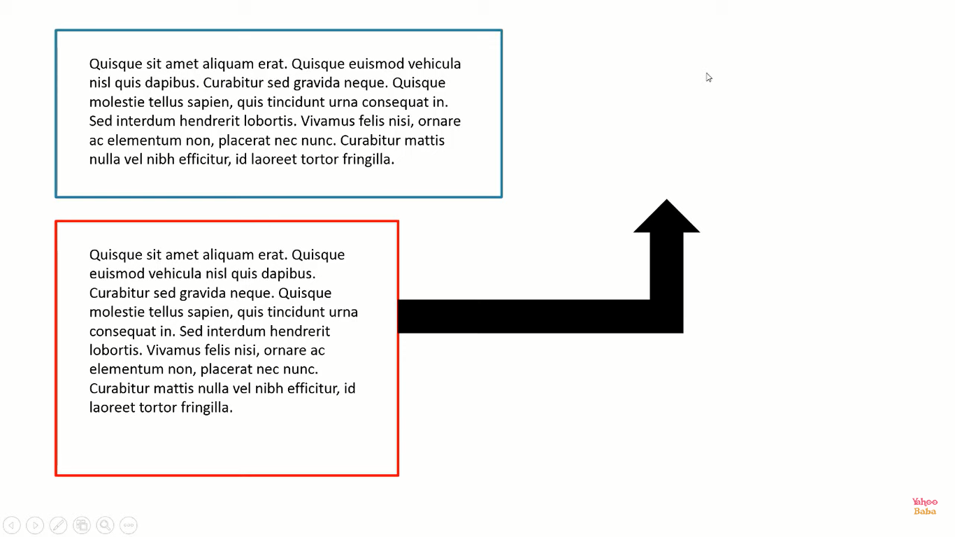

Slide 54
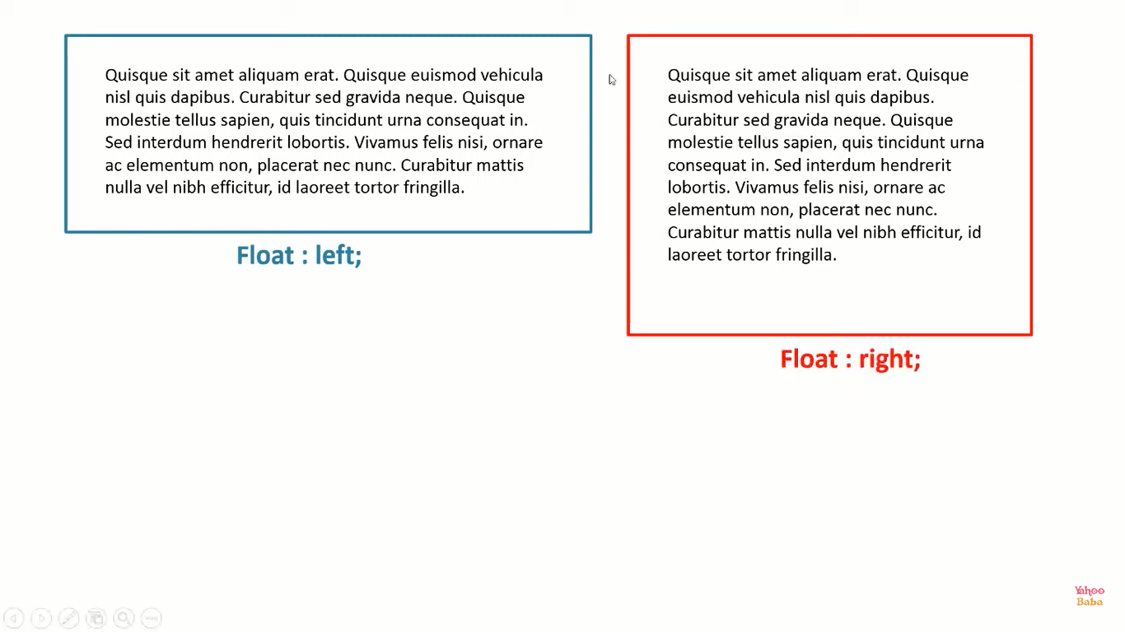

Slide 55


Slide 56


Slide 57


Slide 58


Slide 59


Slide 60


Slide 61

Ranges from [ 100 – 900 ]
[100, 200, 300, …. , 900 ]

Slide 62




Slide 63


Slide 64


Slide 65


Slide 66


Slide 67


Slide 68


Slide 69


Slide 70


Slide 71


Slide 72


Slide 73


Slide 74

By-default

Slide 75


Slide 76


Slide 77


Slide 78


Slide 79


Slide 80




Slide 87


Slide 88


Slide 89


Slide 90


Slide 91

Short-hand

Slide 92


Slide 93


Slide 94


Slide 95


By-default
Stretch Image to some extent

Slide 96


Slide 97

Xpx Ypx

Slide 98


Slide 99

By-default

Slide 100


Slide 101

By-default

Slide 102


Slide 103

By-default

Slide 104


Slide 105

By-default

Slide 106


Slide 107


Slide 108


Slide 109


Slide 110


Slide 111


Slide 112


Slide 113

Values lies between [0, 1]

Slide 114


Slide 115


Slide 116


Slide 117


Slide 118


Slide 119


Slide 120

1) display : none ⬅=== Remove Presence of elements and its area.
2) display : inline ⬅=== block elements acts like inline.
3) display : block ⬅=== inline elements acts like block.
4) display : inline-block ⬅=== block elements behave like inline but some
properties like width and Vertical-margin are not
working properly so using this those
properties are work like element is block
element.
5) display : list-item ⬅=== element behaves like list-item “<li>.

Slide 121


Slide 122


← By-default.
← Remove Presence of elements and but not its area.
Remove Presence of elements and but not its area.
←-- For <table> tag specially.
← Remove Presence of elements and but not its area.

Slide 123
HTML Practice

Slide 124


Slide 125

By-default

Slide 126


Slide 128


Slide 129


Slide 130

By-default value of Z-index is :- 0

Slide 131



Z-Index of B = 1
Z-Index of A = 1

Slide 132


Slide 133


Slide 134


Slide 135


Slide 136


Slide 137


Slide 138


Slide 142


Slide 143

By-default

Slide 144
title attribute
--- Used to show information after hovering specific element.

Slide 145


Slide 146


Slide 147


Slide 148


Slide 149


Slide 150


Takes width & height according parent element.
If Parent element doesn’t exist then body is By-default Parent element.

Slide 151




Slide 152


Slide 153


Global Scope

Slide 154


Local Scope

Slide 155


Slide 156


Slide 157


Slide 158


Slide 159


Slide 160


Slide 161


Slide 162


Slide 163


Slide 164

Shape-margin: 20px

Slide 165


Slide 166


By-Default

Slide 167


Slide 168


Short-hand

Slide 169


